Slide 1
Notes:
Test slide for clicker 1

Slide 2
Notes:
Test slide for clicker 2

Slide 3
Deploy your API secured with a DevSecOps CI/CD pipeline
Eduard Keilholz
Cloud Solution Architect
NIC X Edition
June 1 2022

Slide 4

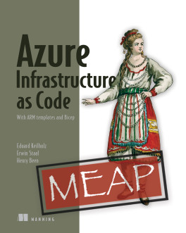
Eduard Keilholz
Cloud Solution Architect
I am a Cloud Solution Architect at 4DotNet (The Netherlands). I focus is on the Microsoft development stack, mainly C# and the Microsoft Azure Cloud.
in: https://www.linkedin.com/in/eduard-keilholz/
tw: @ed_dotnet
gh: https://github.com/nikneem

Slide 5
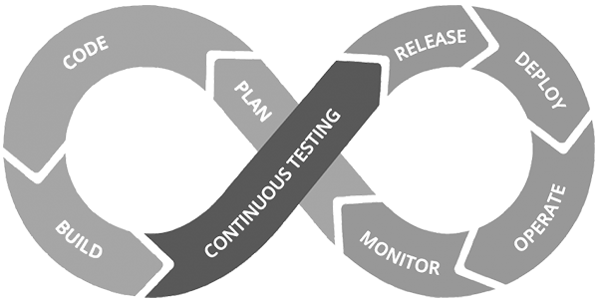
DevSecOps
Development
Security?
Operations
DevOps
Production
Notes:
Development creates new systems
Operations operates, maintains reliability, stability & security
With DevOps, there ‘was’ lack of focus on security

Slide 6
What to work with?
Configure a network
Configure (network) access
Managing secrets
Automation
Maintenance inside your network

Slide 7
Networking in Azure
VNet 1
VNet 2
Subnet
Subnet
Subnet
Subnet
Peering
Notes:
Azure Virtual Network (VNet) is the fundamental building block for your private network in Azure. VNet enables many types of Azure resources, such as Azure Virtual Machines (VM), to securely communicate with each other, the internet, and on-premises networks. VNet is similar to a traditional network that you'd operate in your own data center, but brings with it additional benefits of Azure's infrastructure such as scale, availability, and isolation.

Slide 8



Configure Network
VNet
Subnet
Subnet
Subnet
Public
Internet
Subnet
Notes:
Not a best-practice or should do, just an example
The Application Gateway has a public IP for public internet traffic
It integrates in the Vnet en redirects traffic to API Management
API Management (internal) redirects traffic to API Services

Slide 9
What happened to our secrets?
Deploy-Time Key Vault
Avoid using secrets, go passwordless
Use managed identities where possible
Use a deploy-time Key Vault
Limit access to write-only
Rotate secrets frequently
!! No secrets in configuration !!
Workflow
Provision
Infrastructure
Runtime Key Vault
Notes:
The general recommendation is not to use secrets where possible
Use (System Managed) Identity or User Assigned Identity where possible

Slide 10
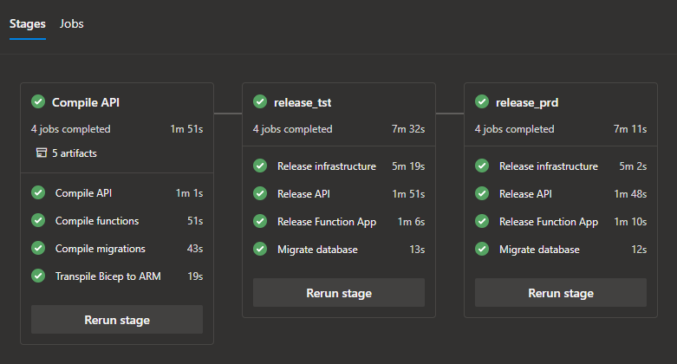
Automate
Use a workflow (as code)
Continuous Integration
Continuous Delivery
Auditable
Version Control

Slide 11
Infrastructure as Code
Repeatable (easy to rebuild & tear down)
Prevent human mistakes
Auditable & Reviewable
Source control
Limit access to production
Details at 16:00, this track

Slide 12
Building a pipeline
Let’s kick it off!

Slide 13
Eduard Keilholz
Thanks for joining
in: https://www.linkedin.com/in/eduard-keilholz/
tw: @ed_dotnet
gh: https://github.com/nikneem

Slide 14
Slides and demos from the conference will be available at
https://github.com/nordicinfrastructureconference/2022
https://github.com/nikneem/secure-api-deployment-demo

